Slide 1

Finite element workshop day 4

Slide 2
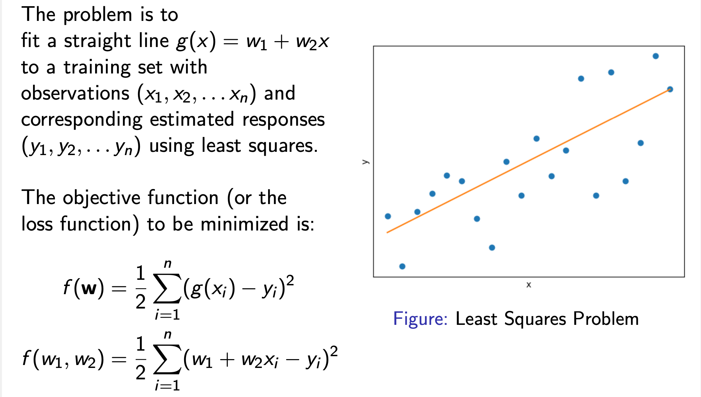
Example 1
Linear Least Squares Problem

Slide 3
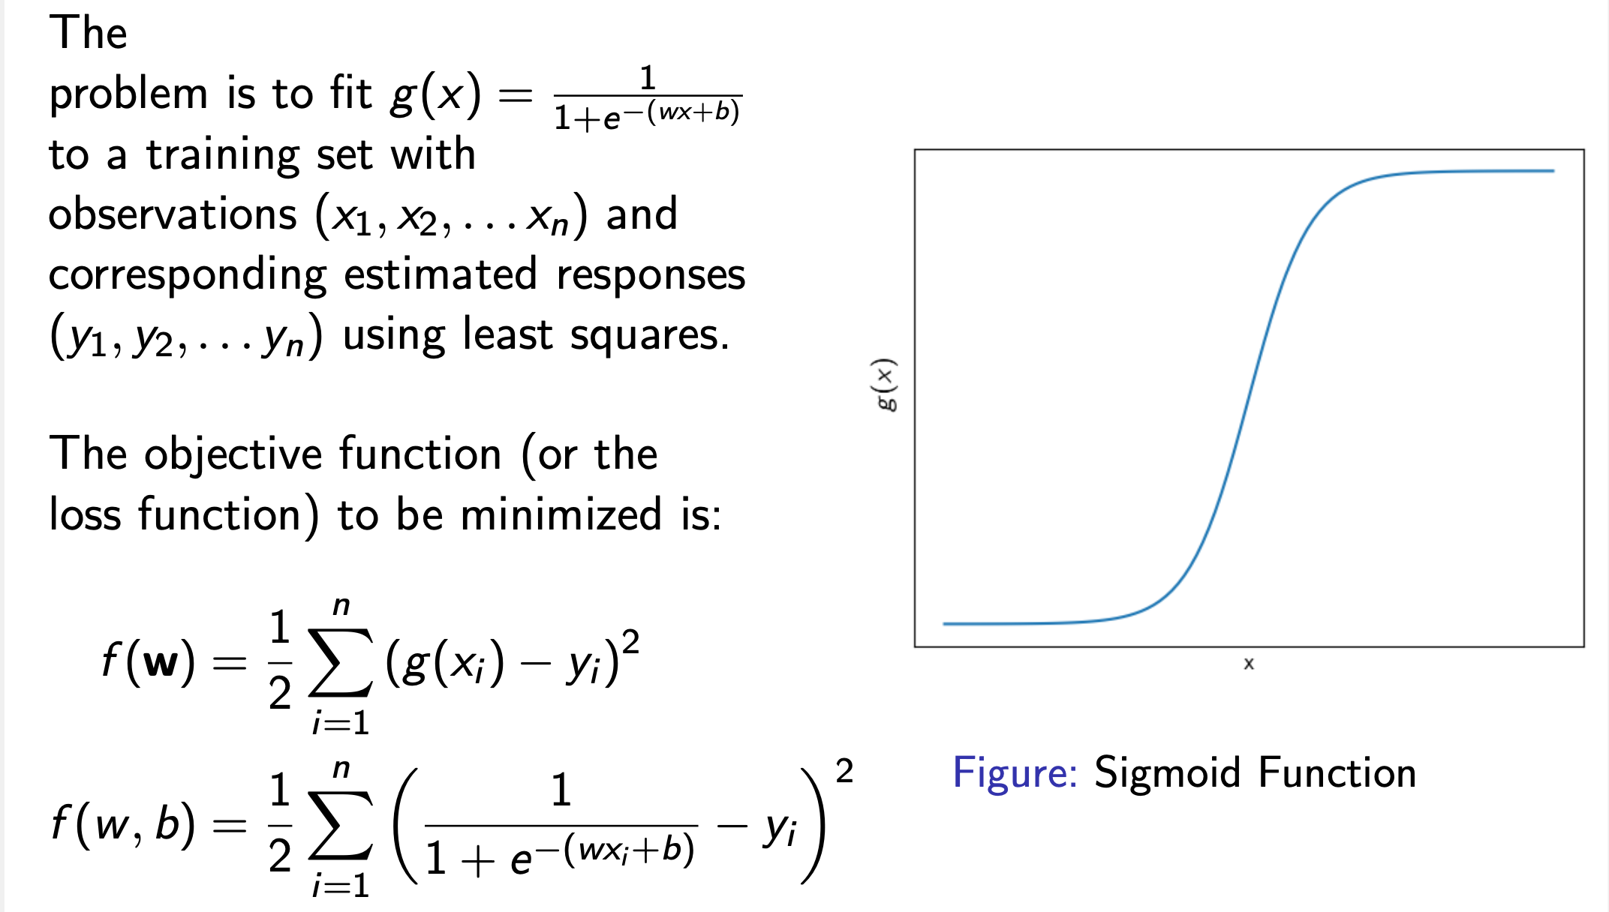
Example 2
Nonlinear Least Squares Problem

Slide 4
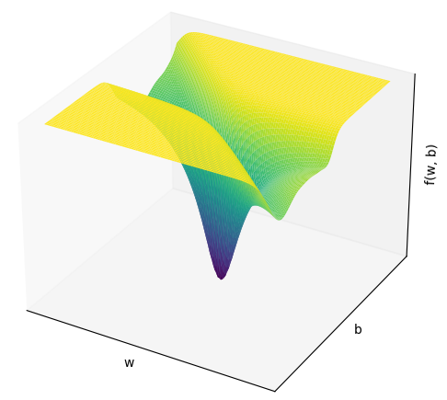
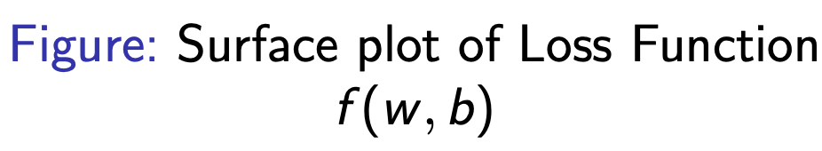
Example 2
Nonlinear Least Squares Problem

Slide 5
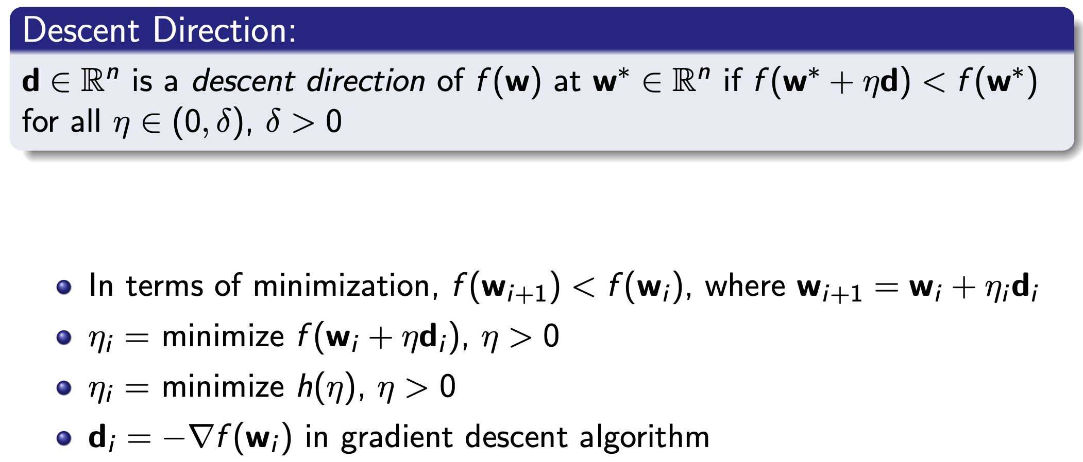
Gradient Descent

Slide 6
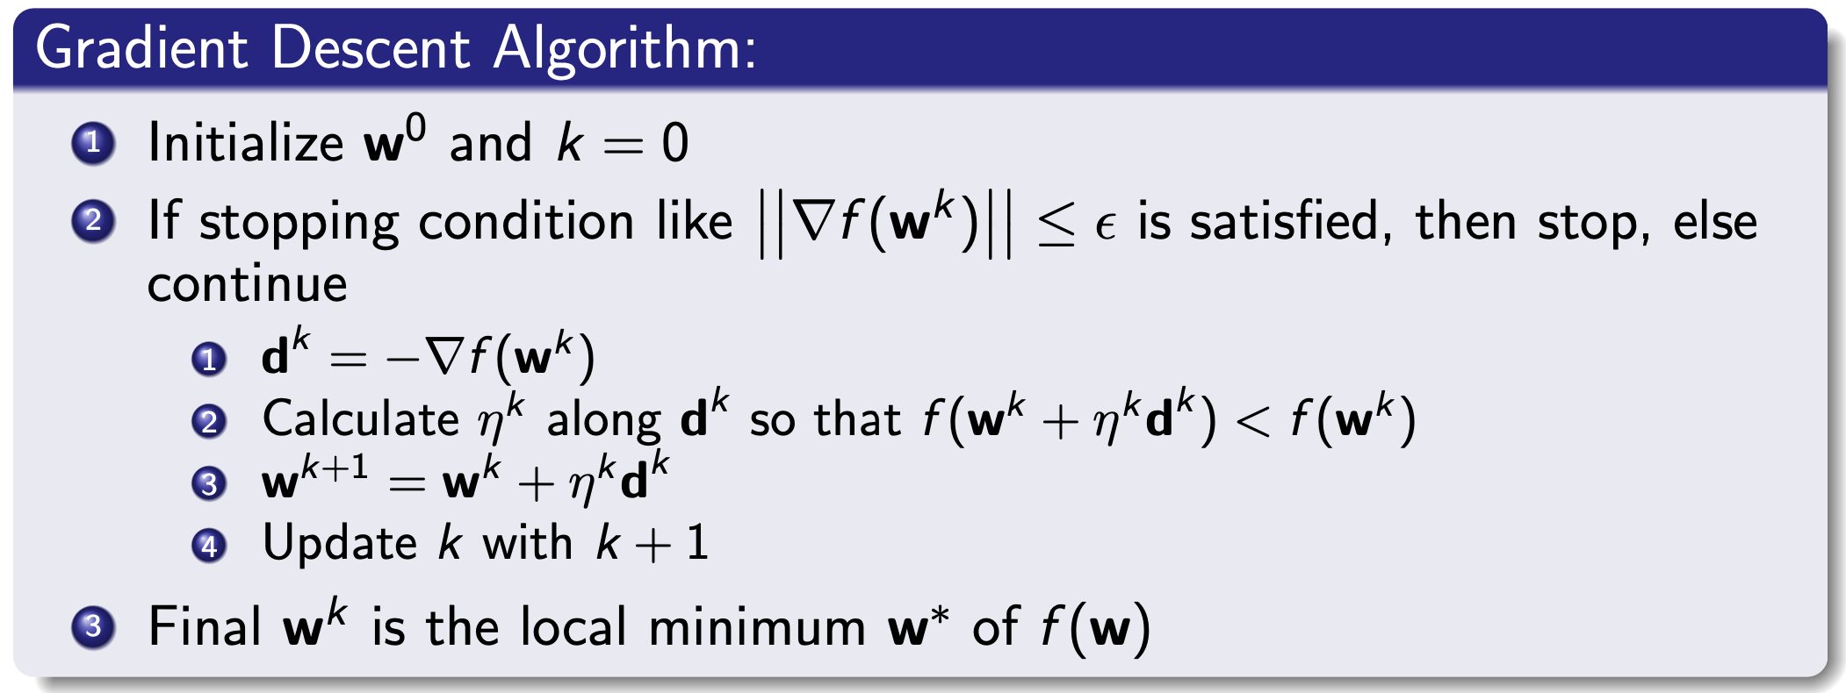
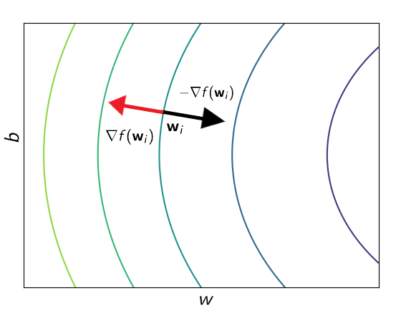
Gradient Descent

Slide 7
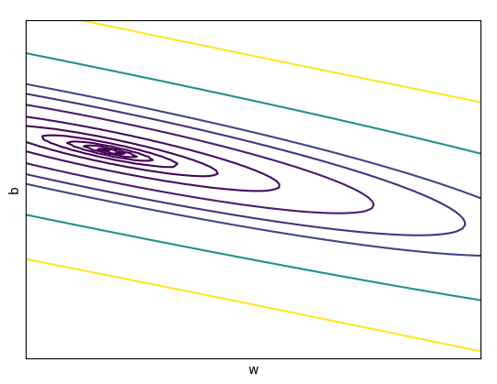
Gradient Descent

Slide 8
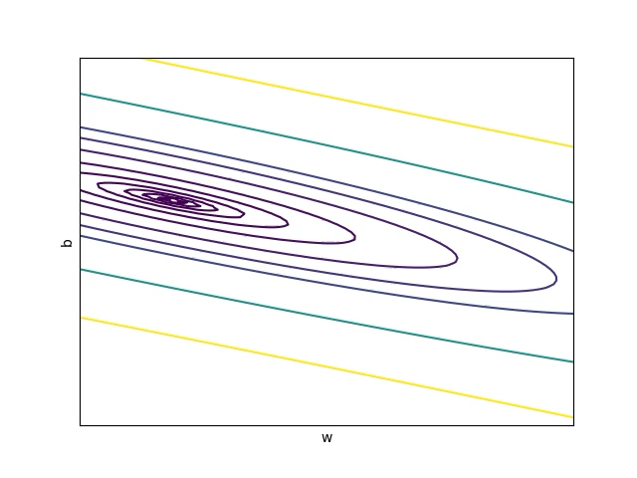
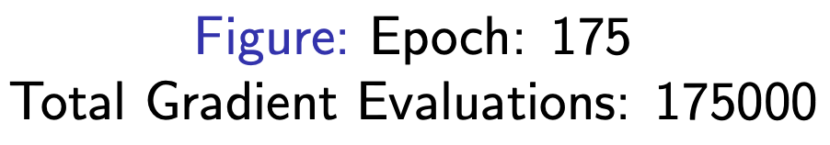
Gradient Descent

Slide 9
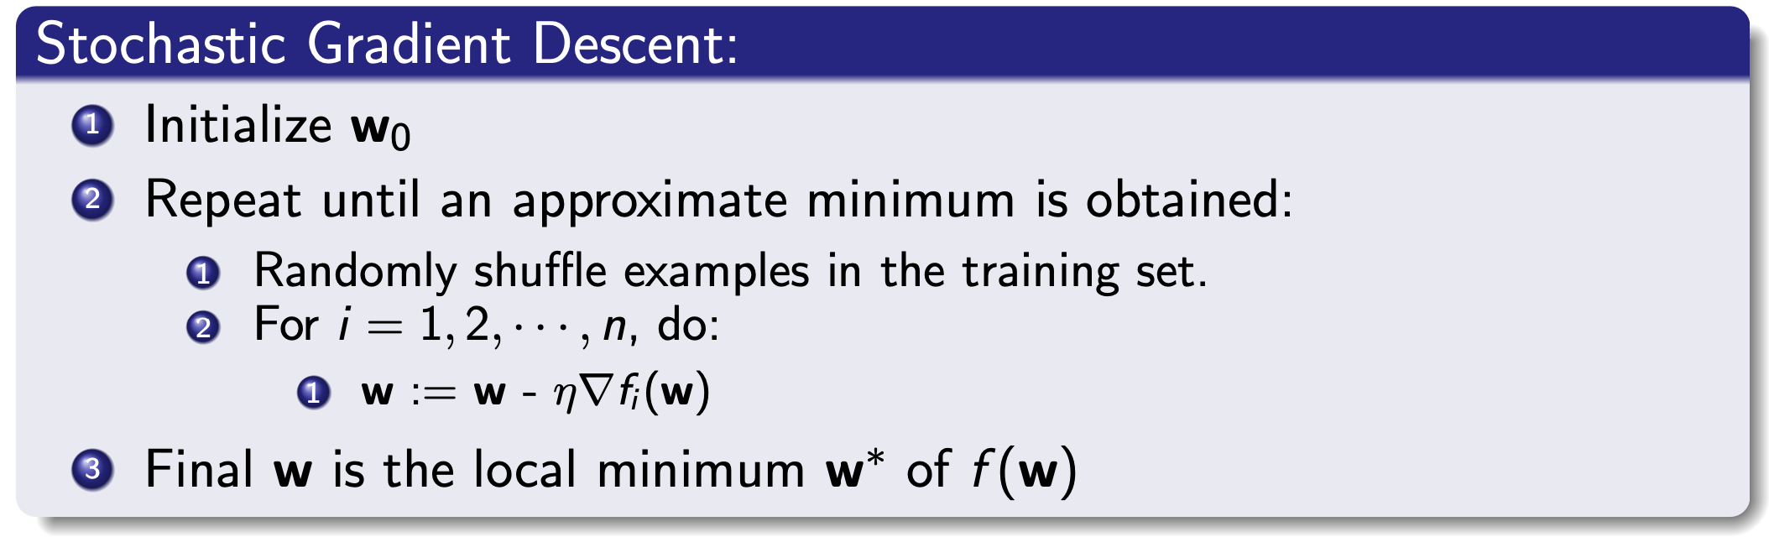
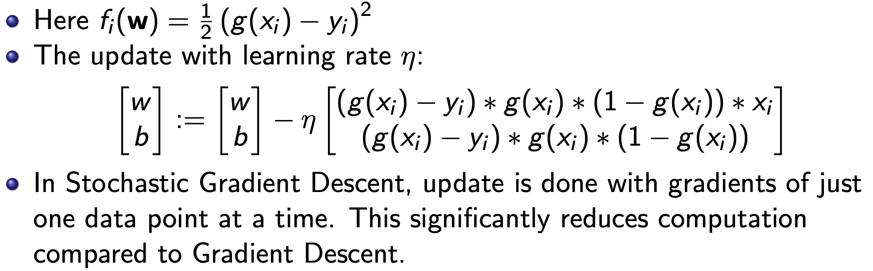
Stochastic Gradient Descent

Slide 10
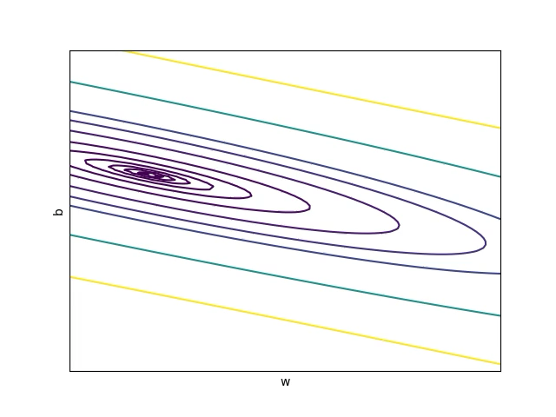
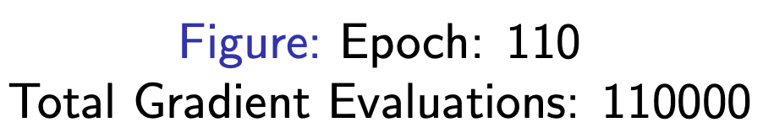
Stochastic Gradient Descent

Slide 11
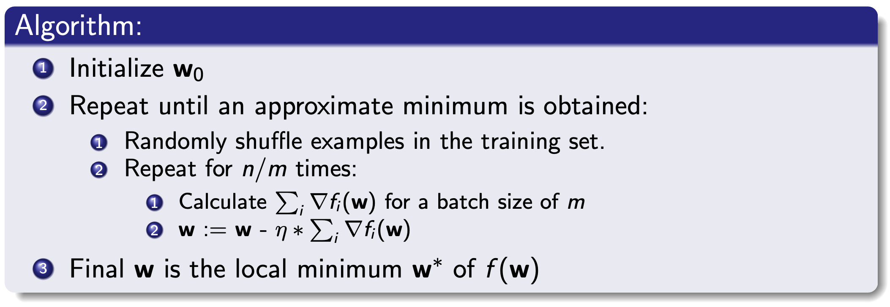
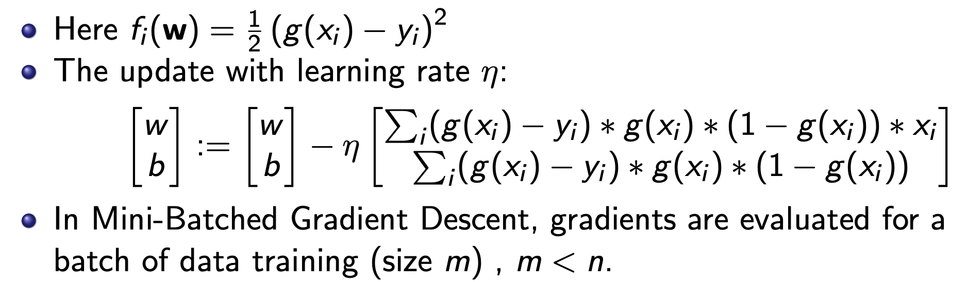
Mini-Batched Gradient Descent

Slide 12

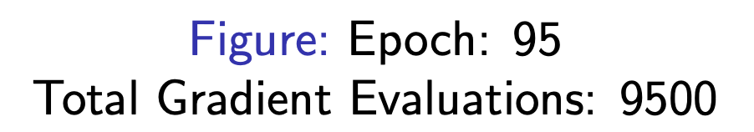
Mini-Batched Gradient Descent

Slide 13
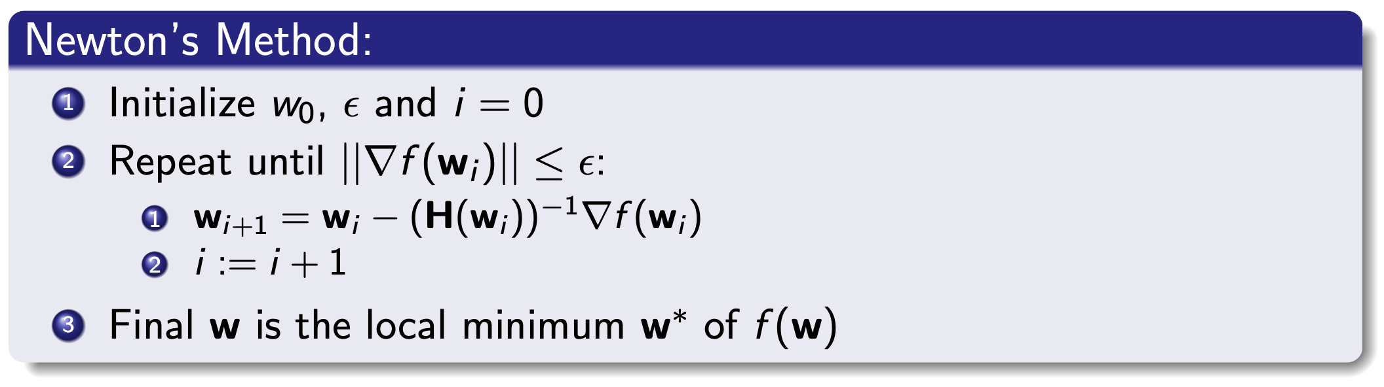
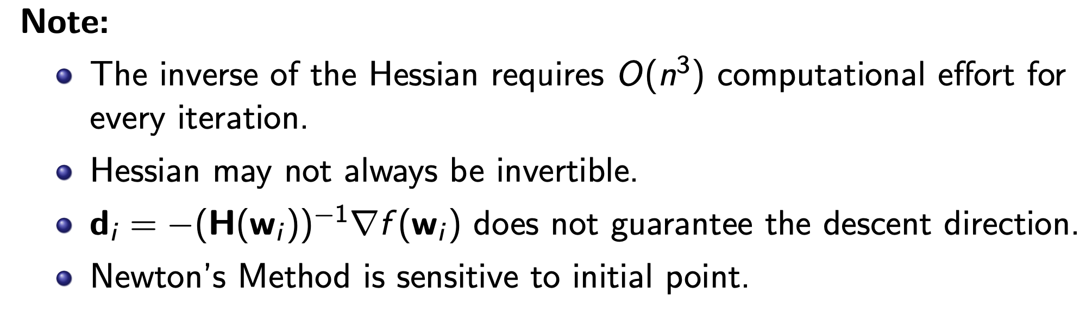
NewTon’s MEthod

Slide 14
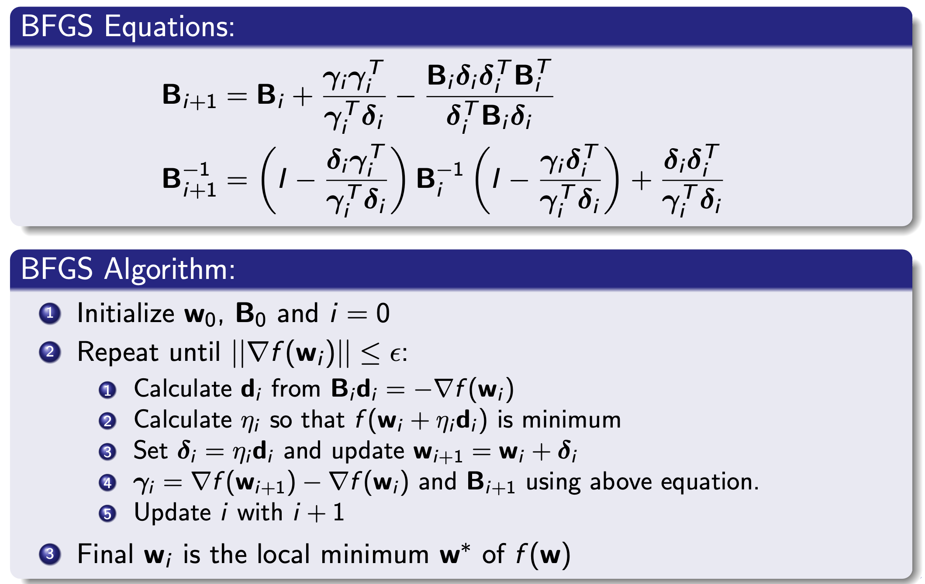
QUASI NewTon’s Method - BFGS

Slide 15
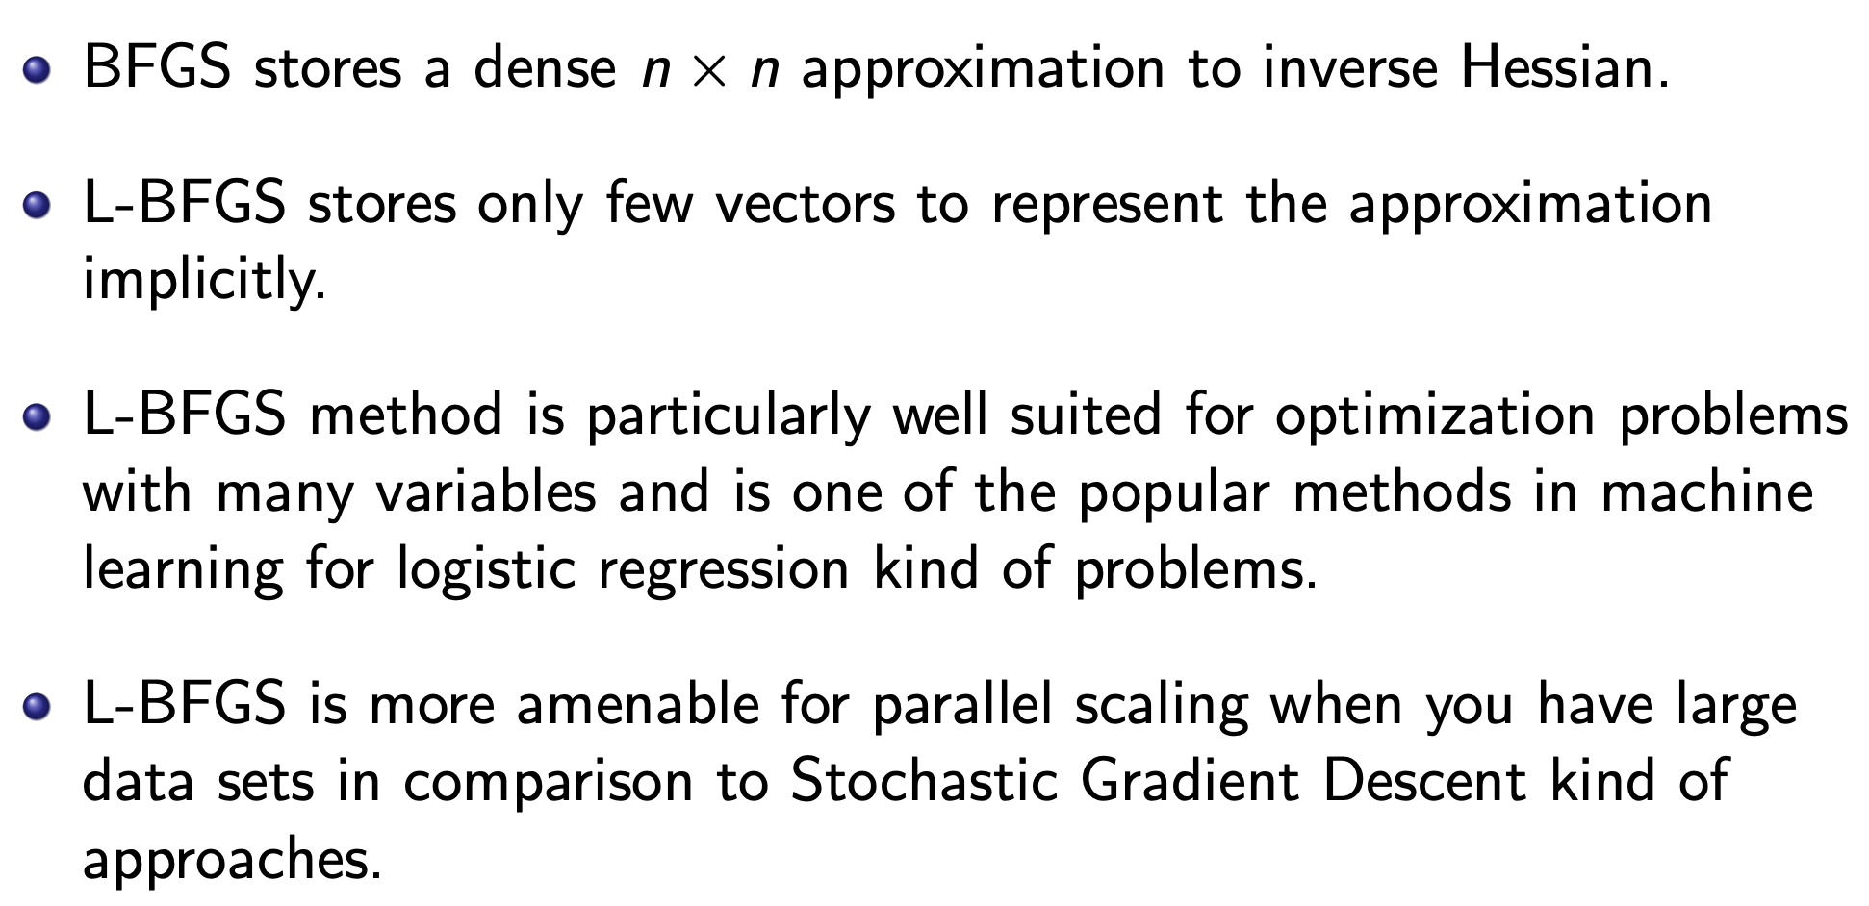
QUASI NewTon’s Method – L-BFGS

Slide 16
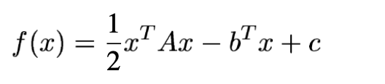
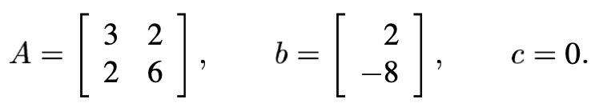
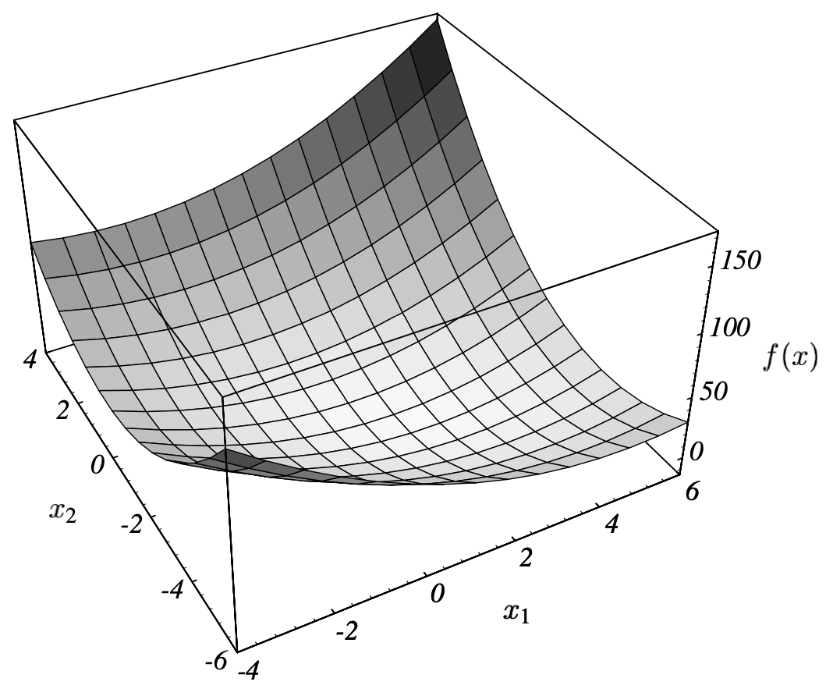
Example 3
Quadratic Form

Slide 17
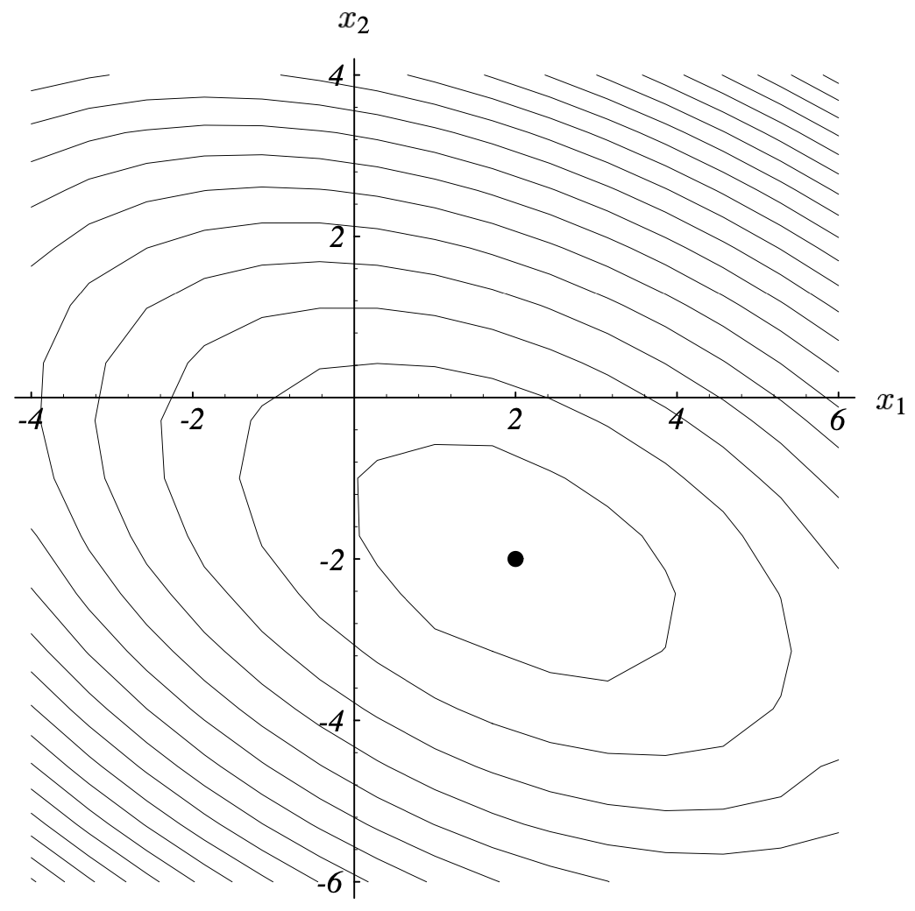
Example 3
Quadratic Form

Slide 18
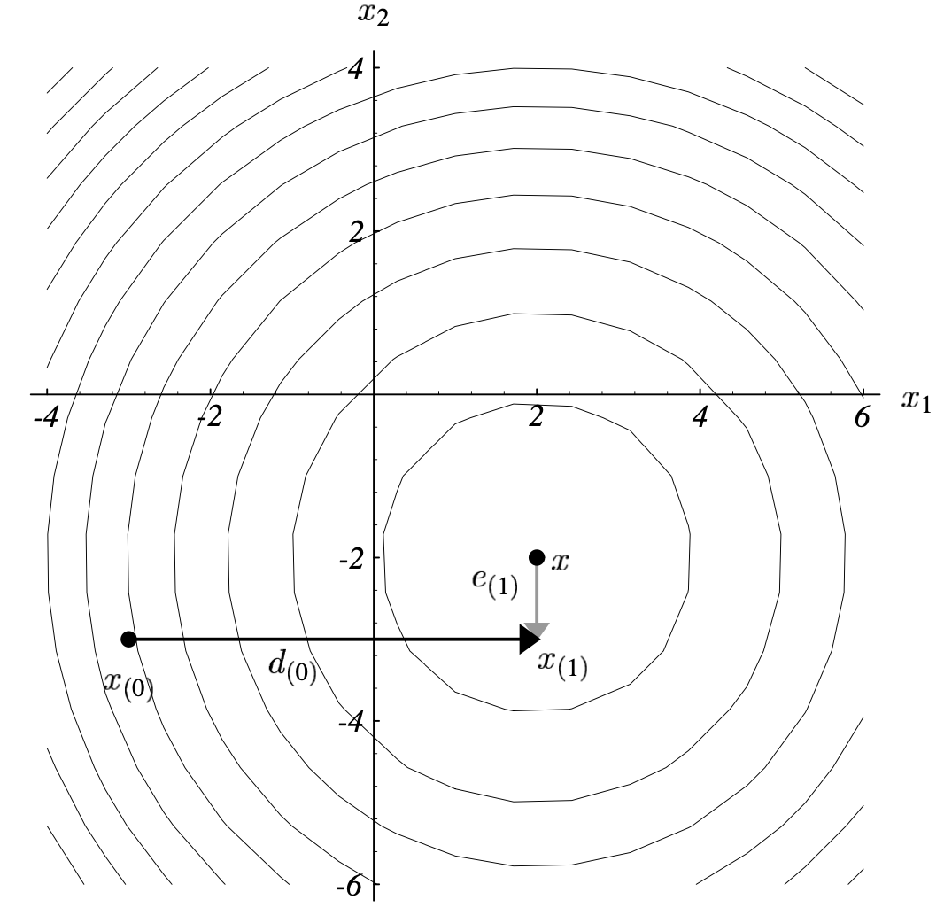
Conjugate Gradient

Slide 19
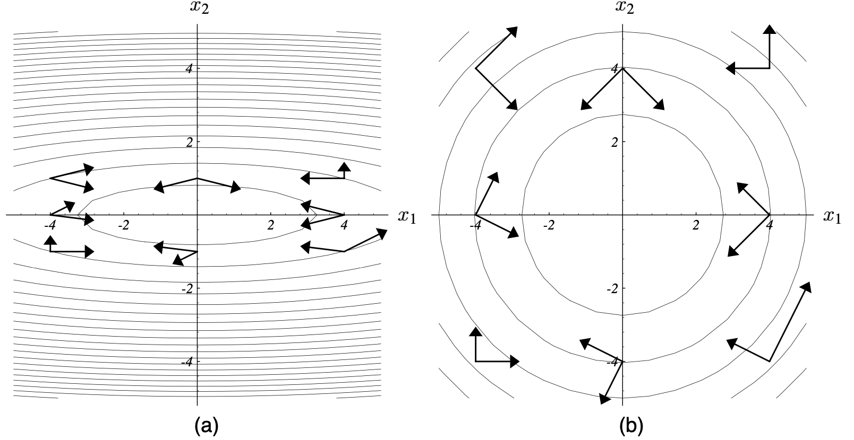
Conjugate Gradient

Slide 20
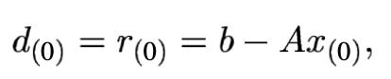
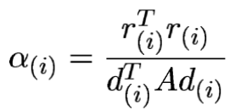
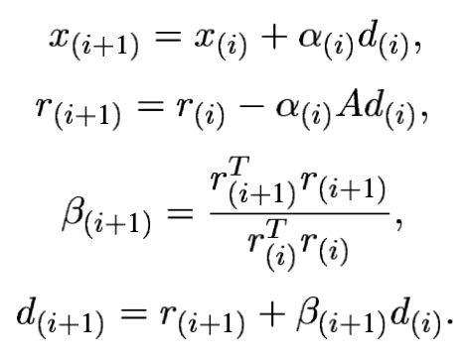
Conjugate Gradient

Slide 21
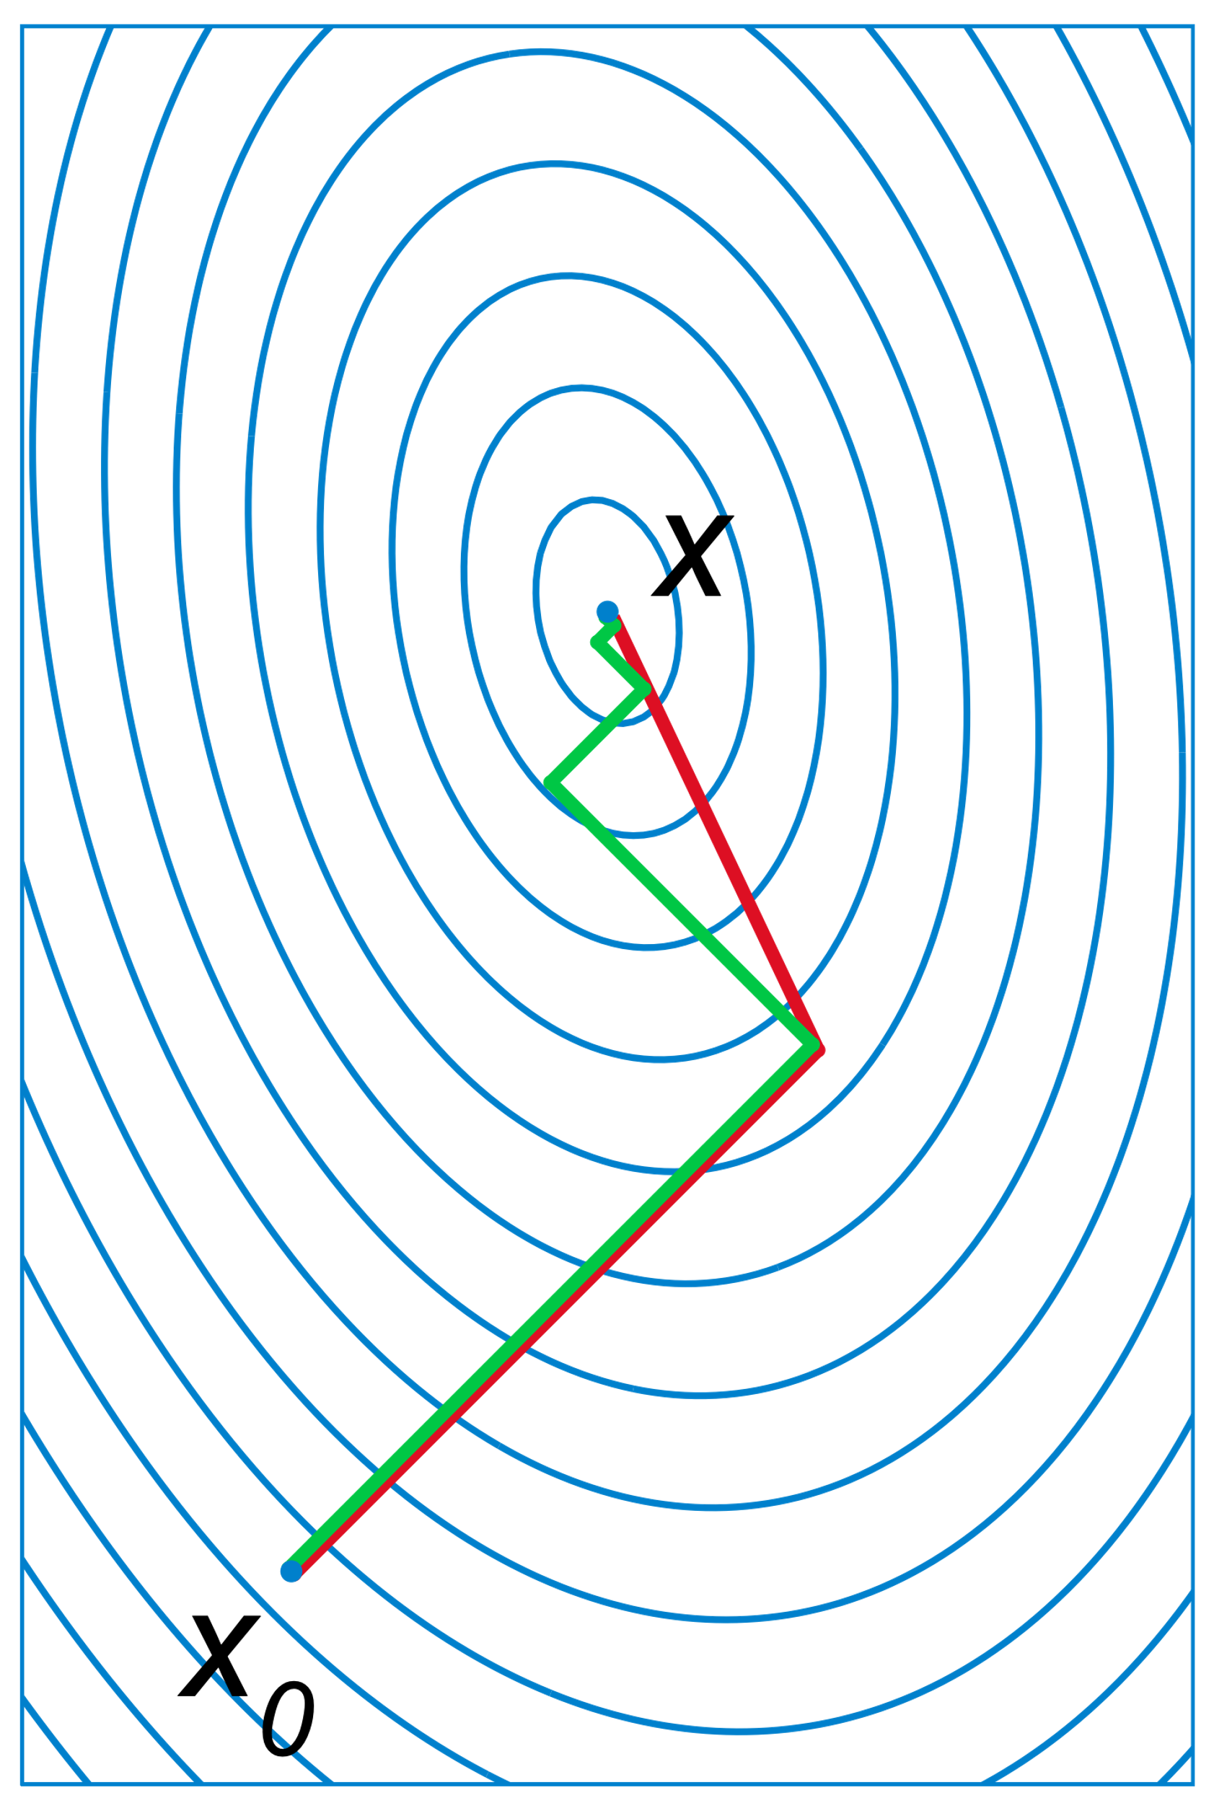
Conjugate Gradient
Gradient Descent (Green) and Conjugate Gradient (Red)

Slide 22
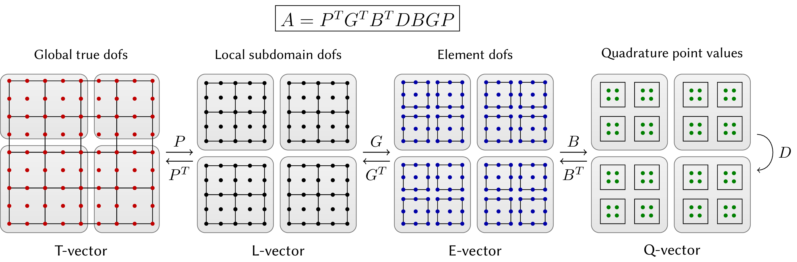
Parallelism in FEM
Domain Decomposition
Ghost update
Construction of
cell-level vectors
Gauss Quadrature
assemble

Slide 23
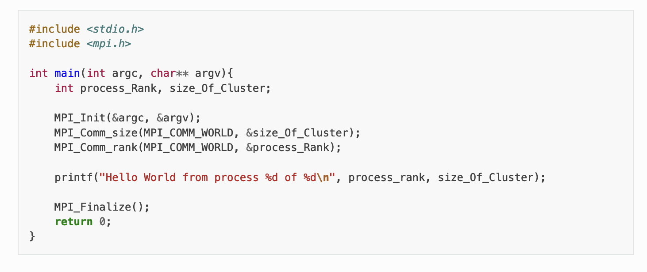
MPI

Slide 24
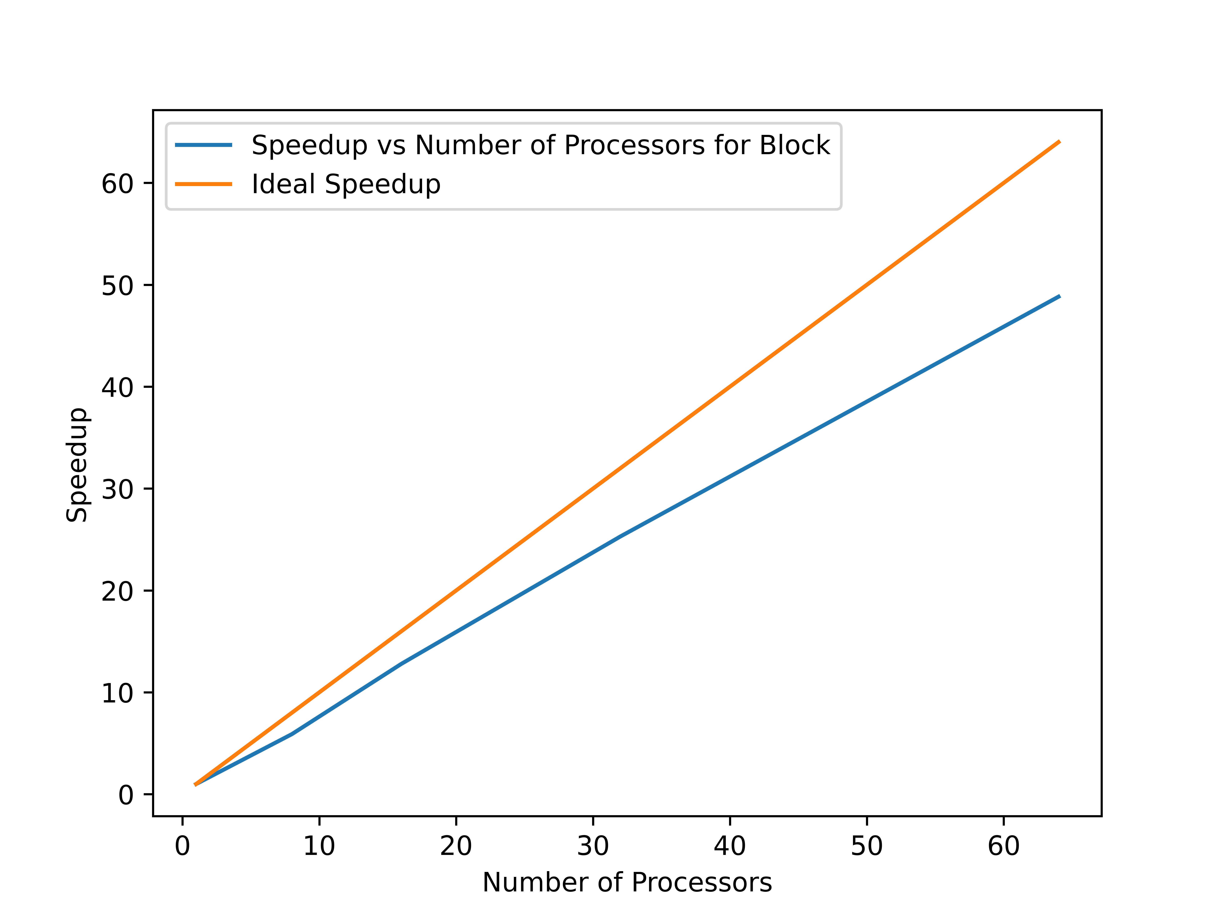
Strong Scaling

Slide 25
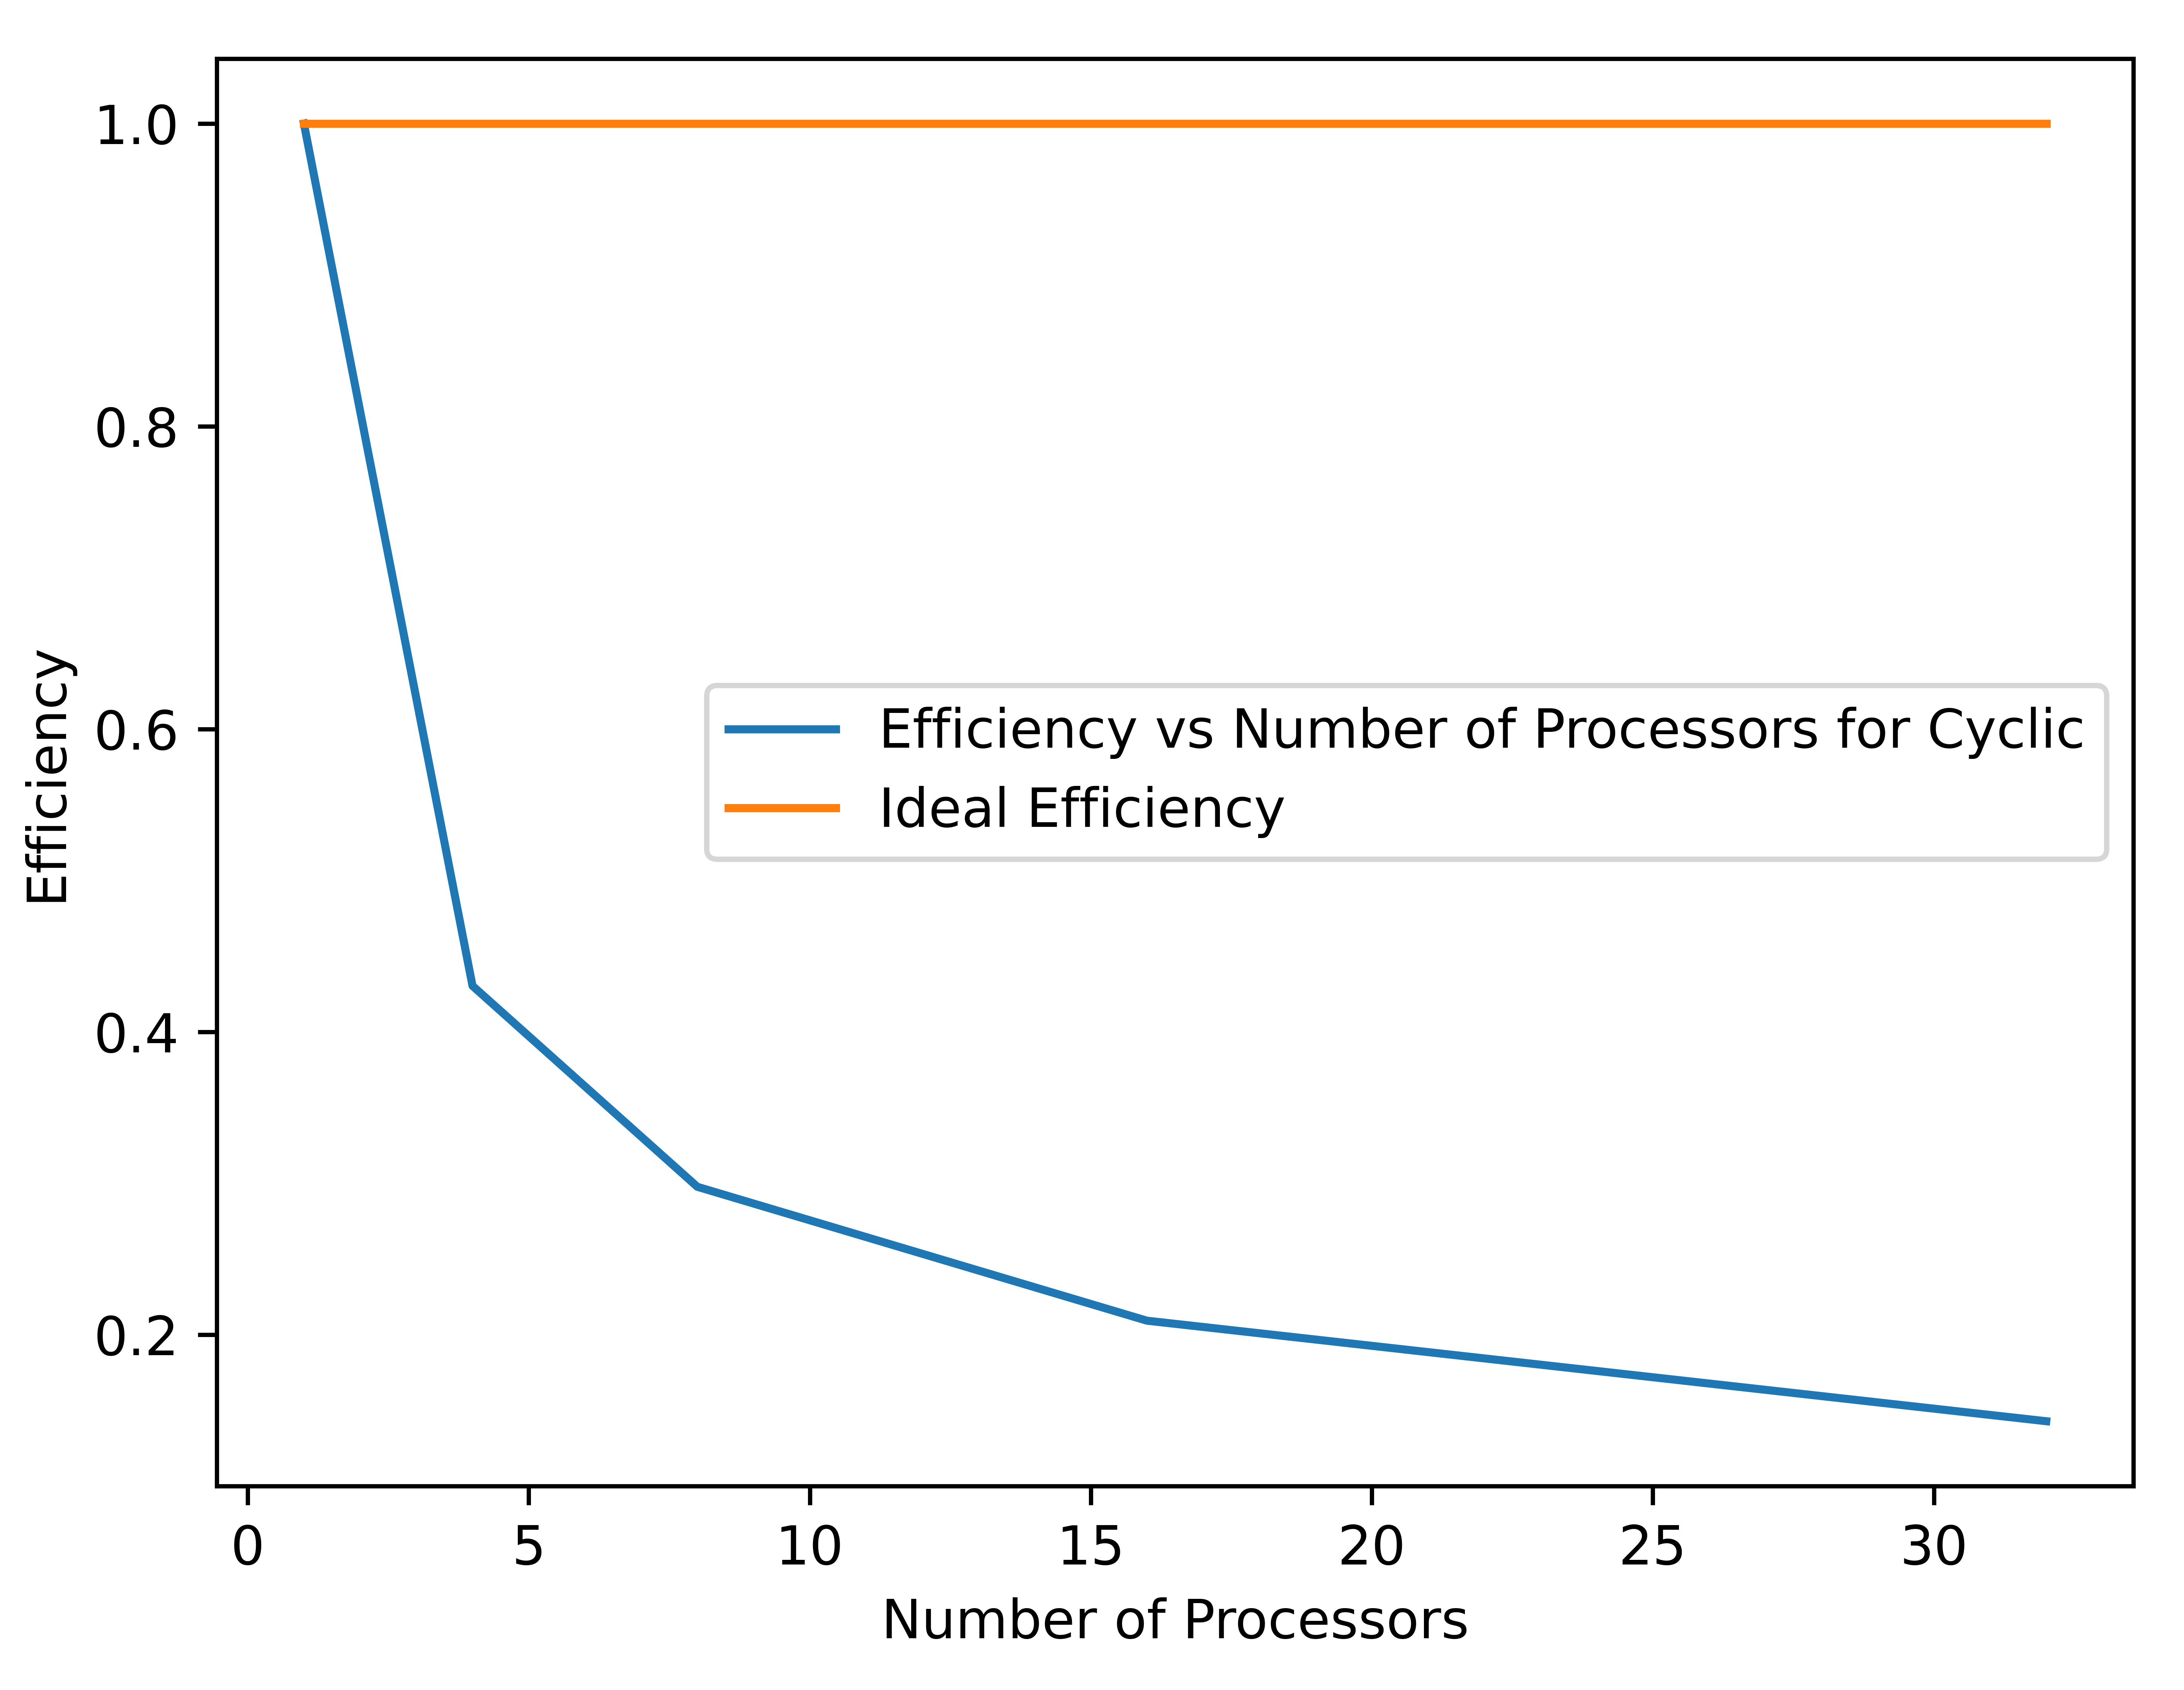
Weak Scaling

Slide 26

Sources
Wikipedia
Painless CG - https://www.cs.cmu.edu/~quake-papers/painless-conjugate-gradient.pdf
Numerical Optimization - Jorge Nocedal, Stephen J. Wright - https://www.csie.ntu.edu.tw/~r97002/temp/num_optimization.pdf
MFEM - https://mfem.org/
MPI Examples – https://curc.readthedocs.io/en/latest/programming/MPI-C.html

